Slide 1
Chapter 13
How to work with control structures, exceptions, and regular expressions

Slide 2
Objectives (part 1)
Applied
Use the identity operators in your control structures.
Use break and continue statements in your while, do-while, and for loops.
Use switch statements, including those that use fall through and default cases.
Use the conditional operator for simple logic requirements.
Use the AND and OR operators for selections.
Use try-catch statements to catch errors.
Create and throw Error objects.
Create regular expressions and use them to match patterns in strings.

Slide 3
Objectives (part 2)
Knowledge
Describe type coercion and distinguish between the equality and identity operators.
Describe the use of break and continue statements in loops.
Describe the use of a switch statement.
Describe the use of a conditional operator as a replacement for an if statement.
Describe how to use non-Boolean values in conditions.
Explain how the short-circuit evaluations of the AND and OR operators can be used in selections.
Describe the use of the try, catch, and finally blocks in a try-catch statement.

Slide 4
Objectives (part 3)
Describe the how to create and throw Error objects.
Describe the use of regular expressions for matching patterns with strings.

Slide 5
The equality operators
Operator Description Example
== Equal lastName == "Hopper"
!= Not equal months != 0

Slide 6
The identity operators
Operator Description Example
=== Equal lastName === "Hopper"
!== Not equal months !== 0

Slide 7
Example 1: The break statement in a while loop
let number = 0;
while (true) {
number = parseInt( prompt(
"Enter a number from 1 to 10.") );
if ( isNaN(number) || number < 1 || number > 10 ) {
alert("Invalid entry. Try again.");
} else {
break;
}
}
alert(number);

Slide 8
Example 2: The continue statement in a while loop
let sum = 0;
let number = 0;
while ( number <= 40 ) {
number++;
if ( number % 5 !== 0 ) {
continue; // if number isn't divisible by 5
}
sum += number;
}
alert(sum);
// displays sum of 5, 10, 15, 20, 25, 30, 35, 40

Slide 9
A switch statement with a default case
switch ( letterGrade ) {
case "A":
message = "well above average";
break;
case "B":
message = "above average";
break;
case "C":
message = "average";
break;
case "D":
message = "below average";
break;
case "F":
message = "failing";
break;
default:
message = "invalid grade";
break;
}

Slide 10
A switch statement with fall through
switch ( letterGrade ) {
case "A":
case "B":
message = "Scholarship approved.";
break;
case "C":
message = "Application requires review.";
break;
case "D":
case "F":
message = "Scholarship not approved.";
break;
}

Slide 11
A function that uses a switch statement to return a value
const getTimeOfDay = ampm => {
switch( ampm.toUpperCase() ) {
case "AM":
return "morning";
case "PM":
return "evening";
default:
return "invalid";
}
};

Slide 12
Syntax of the conditional operator
( conditional_expression ) ? value_if_true : value_if_false

Slide 13
Examples of using the conditional operator
Example 1: Setting a string based on a comparison
const message = ( age >= 18 ) ? "Can vote" : "Cannot vote";
Example 2: Calculating overtime pay
const overtime = ( hours > 40 ) ? ( hours - 40 ) * rate * 1.5 : 0;
Example 3: Selecting a singular or plural ending based on a value
const ending = ( errorCount == 1 ) ? "" : "s".
const message = "Found " + error_count + " error" + ending + ".";
Example 4: Setting a value to 1 if it’s at a maximum value
let value = ( value == maxValue ) ? 1 : value + 1;
Example 5: Returning one of two values based on a comparison
return ( number > highest ) ? highest : number;

Slide 14
How conditional operators can be rewritten with if statements
Example 1 rewritten with an if statement
let message;
if ( age >= 18 ) {
message = "Can vote";
} else {
message = "Cannot vote";
}
Example 4 rewritten with an if statement
if ( value == maxValue ) {
value = 1;
}
else {
value = value + 1;
}

Slide 15
Non-Boolean values evaluated as false
0
"" (Empty string)
null
undefined
an empty array
Non-Boolean values evaluated as true
any number other than zero
any string that isn’t empty
any array that isn’t empty
any object
any symbol

Slide 16
Example 1: An if statement that checks if a variable is initialized
let val;
if (!val) {
alert("Variable 'val' is not initialized");
}
Example 2: An if-else statement that checks for an empty string
const name = prompt("Please enter a name");
if (name) {
alert(name);
} else {
alert("You did not enter a name");
}

Slide 17
Example 3: An if statement that checks for the existence of a property
if (window.navigator.geolocation) {
// code that uses the geolocation property
// of the window object's Navigator object
}

Slide 18
Statements that store a true or false value
Example 1: Using the OR operator
const selected = state === "CA" || state === "NC";
Example 2: Using the AND operator
const canVote = age >= 18 && citizen;
Statements that store a value and provide a default value
Example 3: Using the OR operator
const name = prompt("Please enter a name") || "N/A";
Example 4: Using the nullish coalescing operator
const name = prompt("Please enter a name") ?? "N/A";

Slide 19
Statements that check for the existence of a property
Example 5: Using the AND operator
if (window && window.navigator && window.navigator.geolocation) { ... }
Example 6: Using the optional chaining operator
if (window?.navigator?.geolocation) { ... }

Slide 20
Statements that store the value of a property or a default value if the property doesn’t exist
Example 7: Using the AND and OR operators
const initial = book && book.author && book.author.middleInitial || "No Middle Initial";
Example 8: Using the nullish coalescing and optional chaining operators
const initial = book?.author?.middleInitial ?? "No Middle Initial";

Slide 21
Terms related to control structures
equality operators
type coercion
identity operators
switch statement
switch expression
fall through
conditional expression
truthy value
falsey value
short-circuit evaluation
nullish coalescing operator
optional chaining operator

Slide 22
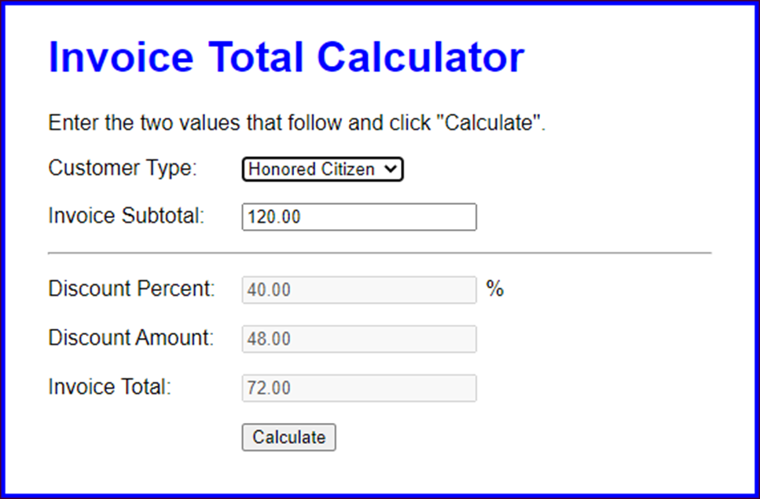
The user interface for the Invoice application

Slide 23
The HTML for the Invoice application (part 1)
<main>
<h1>Invoice Total Calculator</h1>
<p>Enter the two values that follow and click "Calculate".
</p>
<div>
<label for="type">Customer Type:</label>
<select id="type">
<option value="reg">Regular</option>
<option value="loyal">Loyalty Program</option>
<option value="honored">Honored Citizen</option>
</select>
</div>
<div>
<label for="subtotal">Invoice Subtotal:</label>
<input type="text" id="subtotal">
</div>
<hr>
<div>
<label for="percent">Discount Percent:</label>
<input type="text" id="percent" disabled>%
</div>

Slide 24
The HTML for the Invoice application (part 2)
<div>
<label for="discount">Discount Amount:</label>
<input type="text" id="discount" disabled>
</div>
<div>
<label for="total">Invoice Total:</label>
<input type="text" id="total" disabled><br>
</div>
<div>
<label>&nbsp;</label>
<input type="button" id="calculate" value="Calculate">
</div>
</main>

Slide 25
The JavaScript for the Invoice application (part 1)
const calculateDiscount = (customer, subtotal) => {
switch(customer) {
case "reg":
if (subtotal >= 100 && subtotal < 250) {
return .1;
} else if (subtotal >= 250 && subtotal < 500) {
return .25;
} else if (subtotal >= 500) {
return .3;
} else {
return 0;
}
case "loyal":
return .3;
case "honored":
return (subtotal < 500) ? .4 : .5;
}
};

Slide 26
The JavaScript for the Invoice application (part 2)
$( document ).ready( () => {
$("#calculate").click( () => {
const customerType = $("#type").val();
let subtotal = $("#subtotal").val() || 0; // default
subtotal = parseFloat(subtotal);
const discountPercent =
calculateDiscount(customerType, subtotal);
const discountAmount = subtotal * discountPercent;
const invoiceTotal = subtotal - discountAmount;
$("#subtotal").val( subtotal.toFixed(2) );
$("#percent").val( (discountPercent * 100).toFixed(2) );
$("#discount").val( discountAmount.toFixed(2) );
$("#total").val( invoiceTotal.toFixed(2) );
// set focus on type drop-down when done
$("#type").focus();
});
// set focus on type drop-down on initial load
$("#type").focus();
});

Slide 27
The syntax for a try-catch statement
try { statements }
catch([errorName]) { statements }
[ finally { statements } ]
Two properties of Error objects
name
message

Slide 28
A try-catch statement for a calculateFV() function
const calculateFV = (investment, rate, years) => {
try {
let futureValue = investment;
for (let i = 1; i <= years; i++ ) {
futureValue += futureValue * rate / 100;
}
return futureValue.toFixed(2);
}
catch(error) {
alert (error.name + ": " + error.message)
}
};

Slide 29
A catch block that displays a custom message
catch(error) {
alert("The calculateFV function has thrown an error." );
};
A catch block with no error parameter
catch {
alert("The calculateFV function has thrown an error." );
};

Slide 30
The syntax for creating a new Error object
new Error(message)
The syntax for the throw statement
throw errorObject;

Slide 31
A calculateFV() method that throws a new Error object
const calculateFV = ( investment, rate, years ) => {
if ( isNaN(investment) || investment <= 0 ) {
throw new Error(
"calculateFV requires investment greater than 0.");
}
if ( isNaN(rate) || rate <= 0 ) {
throw new Error(
"calculateFV requires annual rate greater than 0.");
}
let futureValue = investment;
for (let i = 1; i <= years; i++ ) {
futureValue += futureValue * rate / 100;
}
return futureValue.toFixed(2);
};

Slide 32
A try-catch statement that catches the Error object that has been thrown
try {
$("future_value").text =
calculateFV(investment, rate, years);
}
catch(error) {
alert (error.name + ": " + error.message);
}
finally {
$("investment").focus();
}

Slide 33
Some of the error types in the Error hierarchy
Type Thrown when
RangeError A numeric value has exceeded the allowable range
ReferenceError A variable is read that hasn’t been defined
SyntaxError A runtime syntax error is encountered
TypeError The type of a value is different from what was expected
A statement that throws a RangeError object
throw new RangeError("Annual rate is invalid.");

Slide 34
Three reasons for using throw statements
To test the operation of a try-catch statement
To throw an error from a function that lets the calling code know that one or more of the arguments that were passed are invalid
To perform some processing after catching an error and then throw the error again

Slide 35
Terms related to exception handling
try-catch statement
exception
exception handling
try block
catch block
finally block
throw an exception
throw statement

Slide 36
Two ways to create a regular expression object
By using the RegExp() constructor
const constantName = new RegExp("expression"[, "flags"]);
By coding a regular expression literal
const constantName = /expression/[flags];

Slide 37
Two statements that create a regular expression that will find “Babbage”
By using the RegExp() constructor
const pattern = new RegExp("Babbage");
By coding a regular expression literal
const pattern = /Babbage/;

Slide 38
One method of a regular expression
test(string)
How to use the test() method
Two strings to test
const inventor = "Charles Babbage";
const programmer = "Ada Lovelace";
How to use the test() method to search for the pattern
alert( pattern.test(inventor) ); // displays true
alert( pattern.test(programmer) ); // displays false

Slide 39
How to create a case-insensitive regular expression
When using the RegExp() constructor
const pattern = new RegExp("lovelace", "i");
When coding a regular expression literal
const pattern = /lovelace/i;
How to use a case-insensitive regular expression
alert( pattern.test(programmer) ); // displays true

Slide 40
Special characters in regular expressions
Pattern Matches
\\ Backslash character
\/ Forward slash
\t Tab
\n Newline
\r Carriage return
\f Form feed
\v Vertical tab
[\b] Backspace (the only special character that must be inside brackets)
\udddd The Unicode character whose value is the four hexadecimal digits.
\xdd The Latin-1 character whose value is the two hexadecimal digits. Equivalent to \u00dd.

Slide 41
How to match special characters
const string =
"©2020 MMA Inc.\nAll rights reserved (8/2020).";
alert( /\//.test(string) );
// matches / and displays true
alert( /\xA9/.test(string) );
// matches © and displays true
const pattern = new RegExp("\\\\"); // same as /\\/
alert( pattern.test(string) ); // displays false since there's no \

Slide 42
Types of characters in regular expressions
Pattern Matches
. Any character except a newline (use \. to match a period)
[ ] Any character in the brackets (use \[ or \] to match a bracket)
[^ ] Any character not in the brackets
[a-z] Any character in the range of characters when used inside brackets
\w Any letter, number, or the underscore
\W Any character that’s not a letter, number, or the underscore
\d Any digit
\D Any character that’s not a digit
\s Any whitespace character (space, tab, newline, carriage return, form feed, or vertical tab)
\S Any character that’s not whitespace

Slide 43
How to match types of characters
const string = "The product code is MBT-3461.";
alert( /MB./.test(string) ); // displays true
alert( /MB[TF]/.test(string) ); // displays true
alert( /MBT-\W/.test(string) ); // displays false

Slide 44
String positions in regular expressions
Pattern Matches
^ The beginning of the string (use \^ to match a caret)
$ The end of the string (use \$ to match a dollar sign)
\b Word characters that aren’t followed or preceded by a word character
\B Word characters that are followed or preceded by a word character

Slide 45
How to match string positions
const inventor = "Charles Babbage";
alert( /^Charles/.test(inventor) ); // displays true
alert( /Babbage$/.test(inventor) ); // displays true
alert( /^Babbage/.test(inventor) ); // displays false
const programmer = "Ada Lovelace";
alert( /Ad/.test(programmer) ); // displays true
alert( /Ad\b/.test(programmer) ); // displays false

Slide 46
How to group and match subpatterns
Pattern Matches
(subpattern) Creates a subpattern (use \( and \) to match a parenthesis)
| Matches either the left or right subpattern (use \| to match a vertical bar)
\n Matches the subpattern in the specified position
Examples
const name = "Rob Robertson";
alert( /^(Rob)|(Bob)\b/.test(name) ); // displays true
alert( /^(\w\w\w) \1/.test(name) ); // displays true

Slide 47
Repeating patterns in regular expressions
Pattern Matches
{n} Pattern must repeat exactly n times (use \{ and \} to match a brace)
{n,} Pattern must repeat n or more times
{n,m} Subpattern must repeat from n to m times
? Zero or one of the previous subpattern (same as {0,1})
+ One or more of the previous subpattern (same as {1,})
* Zero or more of the previous subpattern (same as {0,})

Slide 48
How to match a repeating pattern
const phone = "559-555-6627";
const fax = "(559) 555-6635";
alert( /^\d{3}-\d{3}-\d{4}$/.test(phone) );
// displays true
alert( /^\(\d{3}\) ?\d{3}-\d{4}$/.test(fax) );
// displays true
const phonePattern =
/^(\d{3}-)|(\(\d{3}\) ?)\d{3}-\d{4}$/;
alert( phonePattern.test(phone) ); // displays true
alert( phonePattern.test(fax) ); // displays true

Slide 49
Regular expressions for testing validity
A pattern for testing phone numbers in this format: 999-999-9999
/^\d{3}-\d{3}-\d{4}$/
A pattern for testing credit card numbers in this format: 9999-9999-9999-9999
/^\d{4}-\d{4}-\d{4}-\d{4}$/
A pattern for testing zip codes in either of these formats: 99999 or 99999-9999
/^\d{5}(-\d{4})?$/
A pattern for testing emails in this format: username@mailserver.domain
/^[\w\.\-]+@[\w\.\-]+\.[a-zA-Z]+$/
A pattern for testing dates in this format: mm/dd/yyyy
/^[01]?\d\/[0-3]\d\/\d{4}$/

Slide 50
Examples that use these expressions
Testing a phone number for validity
const phone = "559-555-6624"; // valid number
const phonePattern = /^\d{3}-\d{3}-\d{4}$/;
if ( !phonePattern.test(phone) ) {
alert("Invalid phone number"); // not displayed
}
Testing a date for a valid format, but not for a valid month, day, and year
const startDate = "8/10/220"; // invalid date
const datePattern = /^[01]?\d\/[0-3]\d\/\d{4}$/;
// this will match dates like 19/21/2020 and 9/39/2021
if ( !datePattern.test(startDate) ) {
alert("Invalid start date"); // displayed
}

Slide 51
A function that does more complete validation of an email address
const isEmail = email => {
if (email.length === 0) { return false; }
const parts = email.split("@");
if (parts.length !== 2) { return false; }
if (parts[0].length > 64) { return false; }
if (parts[1].length > 255) { return false; }
const address =
"(^[\\w!#$%&'*+/=?^`{|}~-]+(\\.[\\w!#$%&'*+/=?^`{|}~-]+)*$)";
const quotedText = "(^\"(([^\\\\\"])|(\\\\[\\\\\"]))+\"$)";
const localPart = new RegExp( address + "|" + quotedText );
if ( !localPart.test(parts[0]) ) { return false; }
const hostnames =
"(([a-zA-Z0-9]\\.)|([a-zA-Z0-9][-a-zA-Z0-9]{0,62}[a-zA-Z0-9]\\.))+";
const tld = "[a-zA-Z0-9]{2,6}";
const domainPart = new RegExp("^" + hostnames + tld + "$");
if ( !domainPart.test(parts[1]) ) { return false; }
return true;
};
alert( isEmail("grace@yahoo.com") ); // displays true
alert( isEmail("grace@yahoocom") ); // displays false

Slide 52
Terms related to regular expressions
regular expression
pattern
regular expression object
regular expression literal
flag
escape character
subpattern
quantifier

Slide 53
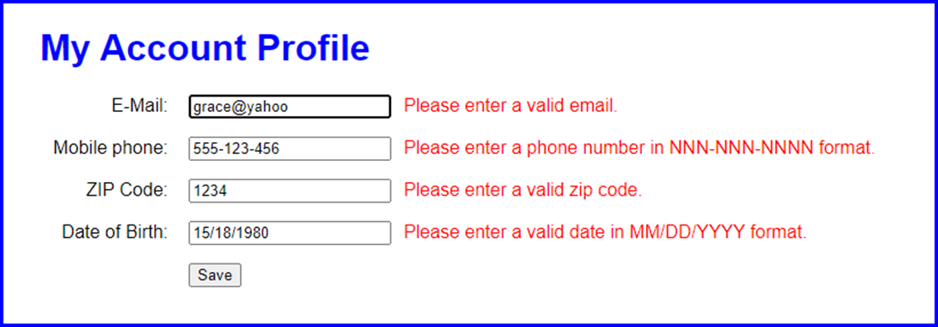
The Account Profile app with error messages

Slide 54
The HTML for the Account Profile app (part 1)
<main>
<h1>My Account Profile</h1>
<div>
<label for="email">E-Mail:</label>
<input type="text" name="email" id="email">
<span></span>
</div>
<div>
<label for="phone">Mobile phone:</label>
<input type="text" name="phone" id="phone">
<span></span>
</div>
<div>
<label for="zip">ZIP Code:</label>
<input type="text" name="zip" id="zip">
<span></span>
</div>

Slide 55
The HTML for the Account Profile app (part 2)
<div>
<label for="dob">Date of Birth:</label>
<input type="text" name="dob" id="dob">
<span></span>
</div>
<div>
<label></label>
<input type="button" id="save" value="Save">
</div>
</main>

Slide 56
The JavaScript for the Account Profile app (part 1)
const isDate = (date, datePattern) => {
if (!datePattern.test(date)) { return false; }
const dateParts = date.split("/");
const month = parseInt( dateParts[0] );
const day = parseInt( dateParts[1] );
if ( month < 1 || month > 12 ) { return false; }
if ( day > 31 ) { return false; }
return true;
};
$( document ).ready( () => {
$( "#save" ).click( () => {
$("span").text("");
// get values entered by user
const email = $("#email").val();
const phone = $("#phone").val();
const zip = $("#zip").val();
const dob = $("#dob").val();

Slide 57
The JavaScript for the Account Profile app (part 2)
// regular expressions for validity testing
const emailPattern = /^[\w\.\-]+@[\w\.\-]+\.[a-zA-Z]+$/;
const phonePattern = /^\d{3}-\d{3}-\d{4}$/;
const zipPattern = /^\d{5}(-\d{4})?$/;
const datePattern = /^[01]?\d\/[0-3]\d\/\d{4}$/;
// check user entries for validity
let isValid = true;
if ( email === "" || !emailPattern.test(email) ) {
isValid = false;
$("#email").next().text(
"Please enter a valid email.");
}
if ( phone === "" || !phonePattern.test(phone) ) {
isValid = false;
$("#phone").next().text(
"Please enter a phone number " +
"in NNN-NNN-NNNN format.");
}
if ( zip === "" || !zipPattern.test(zip) ) {
isValid = false;
$("#zip").next().text(
"Please enter a valid zip code.");
}

Slide 58
The JavaScript for the Account Profile app (part 3)
if ( dob === "" || !isDate(dob, datePattern) ) {
isValid = false;
$("#dob").next().text(
"Please enter a valid date " +
"in MM/DD/YYYY format.");
}
if ( isValid ) {
// code that saves profile info goes here
}
$("#email").focus();
});
// set focus on initial load
$("#email").focus();
});

